Slide 1
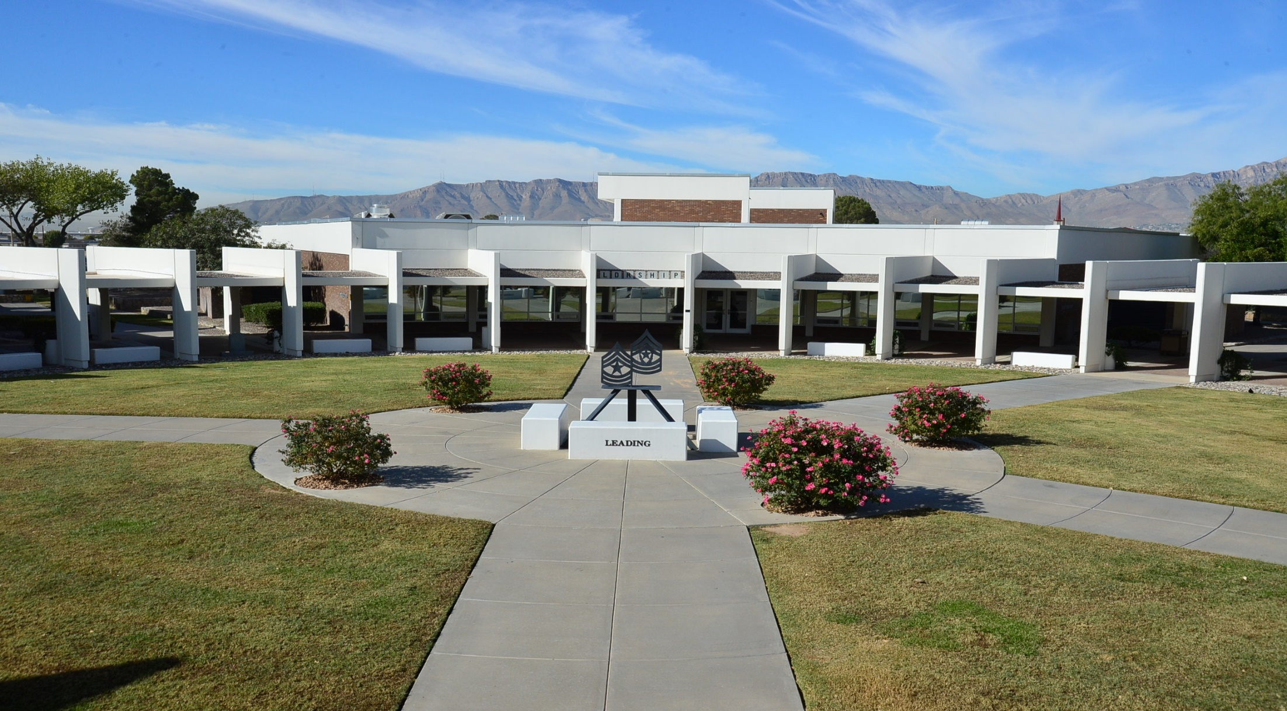
In-processing

Slide 2
The MEO Program formulates, directs, and sustains a comprehensive effort to maximize human potential and to ensure fair treatment for all Soldiers based solely on merit, performance, and potential in support of readiness. MEO philosophy is based on fairness, justice, and equity. Commanders are responsible for sustaining a positive EO climate within their units.
Bases of Discrimination
Types of Harassment
Other MEO Concerns
Color
Sex (including Gender Identity)
Race
Religion
National Origin
Sexual Orientation
Hazing
Bulling
Discriminatory
Other acts of misconduct
Online misconduct
Disparaging terms
Reprisal
Retaliation

Slide 3
BASES OF DISCRIMINATION
AR 600–20 • 24 July 2020
a. Color discrimination. Occurs when an individual is treated differently based on the lightness, darkness or toner color characteristics of the person. This type of discrimination can occur with race discrimination. Color discrimination can occur between persons of different races or ethnicities. It can also occur when members of the same race treat each other differently because of lightness or darkness of their skin.
b. Sex discrimination. Occurs when an individual is deprived of an opportunity because of their sex (including gender identity and pregnancy) or when decisions are made based on stereotypes and assumptions about abilities, traits, or the performance of individuals on the basis of sex.
c. Racial discrimination. Occurs when an individual is treated differently because of their racial group, racial characteristics (for example, hair texture, color, facial features), or because of their relationship or association with someone of a particular race. Racial discrimination applies regardless of whether the discrimination is directed at Whites, Blacks or African Americans, Asians or Pacific Islanders, Hispanics or Latinos, Native Americans, American Indian or Alaska Natives, multi-racial individuals, or other ethnicities.
d. Religious discrimination. Occurs when an individual is treated more or less favorably because of their religious beliefs or practices––except to the extent a religious accommodation is warranted. For example, imposing stricter promotion requirements for a person of a certain religious or imposing more or different work requirements on an individual because of their religious beliefs or practices, or forcing an individual to participate––or not participate––in a religious activity.
e. National origin discrimination. Occurs when an individual is treated less favorably because of their origin, ethnicity or accent, or because it is believed they are a particular nationality.
f. Sexual orientation discrimination. One’s emotional or physical attraction to the same and/or opposite sex (homo-sexuality, bisexuality, or heterosexuality). Complaints may be based on actual or perceived sexual orientation, as well as association with an individual or affinity group associated with a particular sexual orientation.

Slide 4
TYPES OF HARASSMENT
AR 600–20 • 24 July 2020
a. Hazing. A form of harassment that includes conduct through which Soldiers or DA Civilian employees (who haze Soldiers), without a proper military authority or other governmental purpose but with a nexus to military service, physically or psychologically injures or creates a risk of physical or psychological injury to Soldiers for the purpose of: initiation into, admission into, affiliation with, change in status or position within, or a condition for continued membership in any military or DA Civilian organization.
b. Bullying. A form of harassment that includes acts of aggression by Soldiers or DA Civilian employees, with a nexus to military service, with the intent of harming a Soldier either physically or psychologically, without proper military authority or other governmental purpose. Bullying is the exposure of an individual or group to physical and/or emotional aggression with the intent to cause distress or harm. Bullying may involve the singling out of an individual from his or her coworkers, or unit, for ridicule because he or she is considered different or weak. It often is indirect or subtle in nature and involves an imbalance of power between the aggressor and the victim.
c. Discriminatory harassment. Unwelcomed harassment based on the six bases of discrimination.
d. Other acts of misconduct. Misconduct may or may not meet the definitions above for hazing or bullying, yet may violate the dignity and respect of others. Additionally, other policy, regulation or law, and/or violations against persons as outlined in the UCMJ may violate the provisions of this paragraph.
e. Online misconduct. The use of electronic communication to inflict harm. Electronic communication is the transfer of information (signs, writing, images, sounds, or data) transmitted by computer, phone or other electronic device via text messages, emails, chats, instant messaging, screensavers, blogs, social media sites, electronic device applications, and Web/video conferencing. Examples of online misconduct include, but are not limited to: hazing, bullying, harassment, discriminatory harassment, stalking, retaliation, or any other types of misconduct that undermines dignity and respect. When using electronic communication devices, Army personnel should apply “Think, Type, and Post”: “Think” about the message being communicated and potential viewer; “Type” a communication that is consistent with Army values; and “Post” only those messages that demonstrate dignity and respect for self and others.

Slide 5
OTHER MEO CONCERNS
AR 600–20 • 24 July 2020
a. Disparaging Terms. Terms used to degrade, belittle, insult, or negative statements pertaining to race, color, sex (including gender identity), national origin, or religion. These terms include insults, printed material, visual material, signs, symbols, posters, or insignia. The determining factor whether a term is disparaging is not the intent but the impact it has on the recipient or a reasonable person. The use of these terms may contribute to an unlawful hostile work environment if it occurs with respect to a person’s race, color, sex (including gender identity), national origin, or religion and must not be tolerated.
b. Disparaging Treatment. Treatment that is different and unequal because of race, color, sex (including gender identity), national origin, or religion, or sexual orientation.
c. Reprisal. Taking or threatening to take an unfavorable personnel action, or withholding or threatening to withhold a favorable personnel action, or any other act of retaliation, against a Soldier or Family member, for making or preparing a formal MEO complaint, a DA Civilian for engaging in activity in opposition to perceived discrimination; or against an alleged subject under investigation.
d. Retaliation. Any person subject to the UCMJ who wrongfully takes or threatens to take an adverse personnel action, or wrongfully withholds or threatens to withhold a favorable personnel action with the intent to discourage or retaliate against any person for reporting or planning to report a criminal offense, or making, or planning to make a protected communication. (See Article 132, UCMJ (2019))

Slide 6
BYSTANDER INTERVENTION
A bystander is someone who witnesses some action, situation, or event. Bystander Intervention is assessing the situation to determine what type of intervention, if any, might be appropriate. Bystander intervention can also mean stepping in, acknowledging, and recognizing positive behaviors. Bystander effect (also known as bystander apathy) is a psychological phenomenon where persons are less likely to intervene in a situation when others are present than when they are alone.
a. Active Bystander. Often intervenes if another person needs help. Will often do this for complete strangers, sometimes even at great personal risk. Also, an active bystander is someone that is 1) Willing to safely take action and help someone in time of need. 2) Looking out for situations that could require some intervention. 3) Take the imitative in a situation that is uncomfortable.
b. Passive Bystander. Someone that doesn’t actively engage. An individual or group that should do something but does not.
c. Strategies associated with active bystander intervention.
Direct Action
Safety First
Think before you act
Decide how to help, be friendly, be firm, avoid violence
When in doubt, trust your gut. Instincts are there for a reason
When a situation makes us feel uncomfortable, it is generally a good indicator that something is not right.

Slide 7
References
DoDI 1350.02 DoD Military Equal Opportunity Program
DoDI 1020.05 DoD Diversity and Inclusion Management Program
DoDI 1300.28 In-Service Transition for Transgender Service Members
DODI 6400.07 Victim Assistance Services in the Military Community
DoDI 1020.03, Harassment and Prevention and Response in the Armed Forces
DoDD 7050.06, Whistle Blower Protection
AR 350-1 Army Training and Leader Development
AR 600-20 Army Command Policy
DA PAM 600-26 Department of the Army Affirmative Action Plan

Slide 8
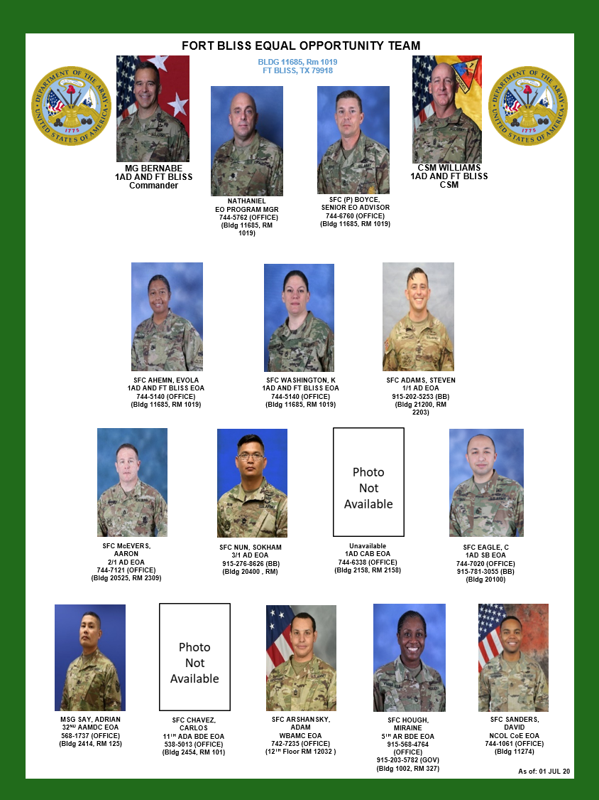

Slide 9
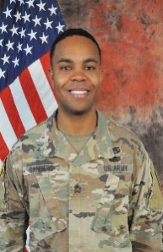
BLUF: Assist the Commander in promoting and sustaining a climate of equality, fair treatment, and advancement for all Soldiers, regardless of race, religion gender, color, national origin, or sexual orientation. Ensure all Soldier considerations are based solely on merit, fitness, and capability in support of organizational readiness.
NCOLCoE EOA:
SFC Sanders, David:
Office: (915) 744-1061
Cell: (915) 494-8886
e-mail: david.m.sanders68.mil@mail.mil
Rm 14 in the LRC (Bldg. 11294)

